Slide 1

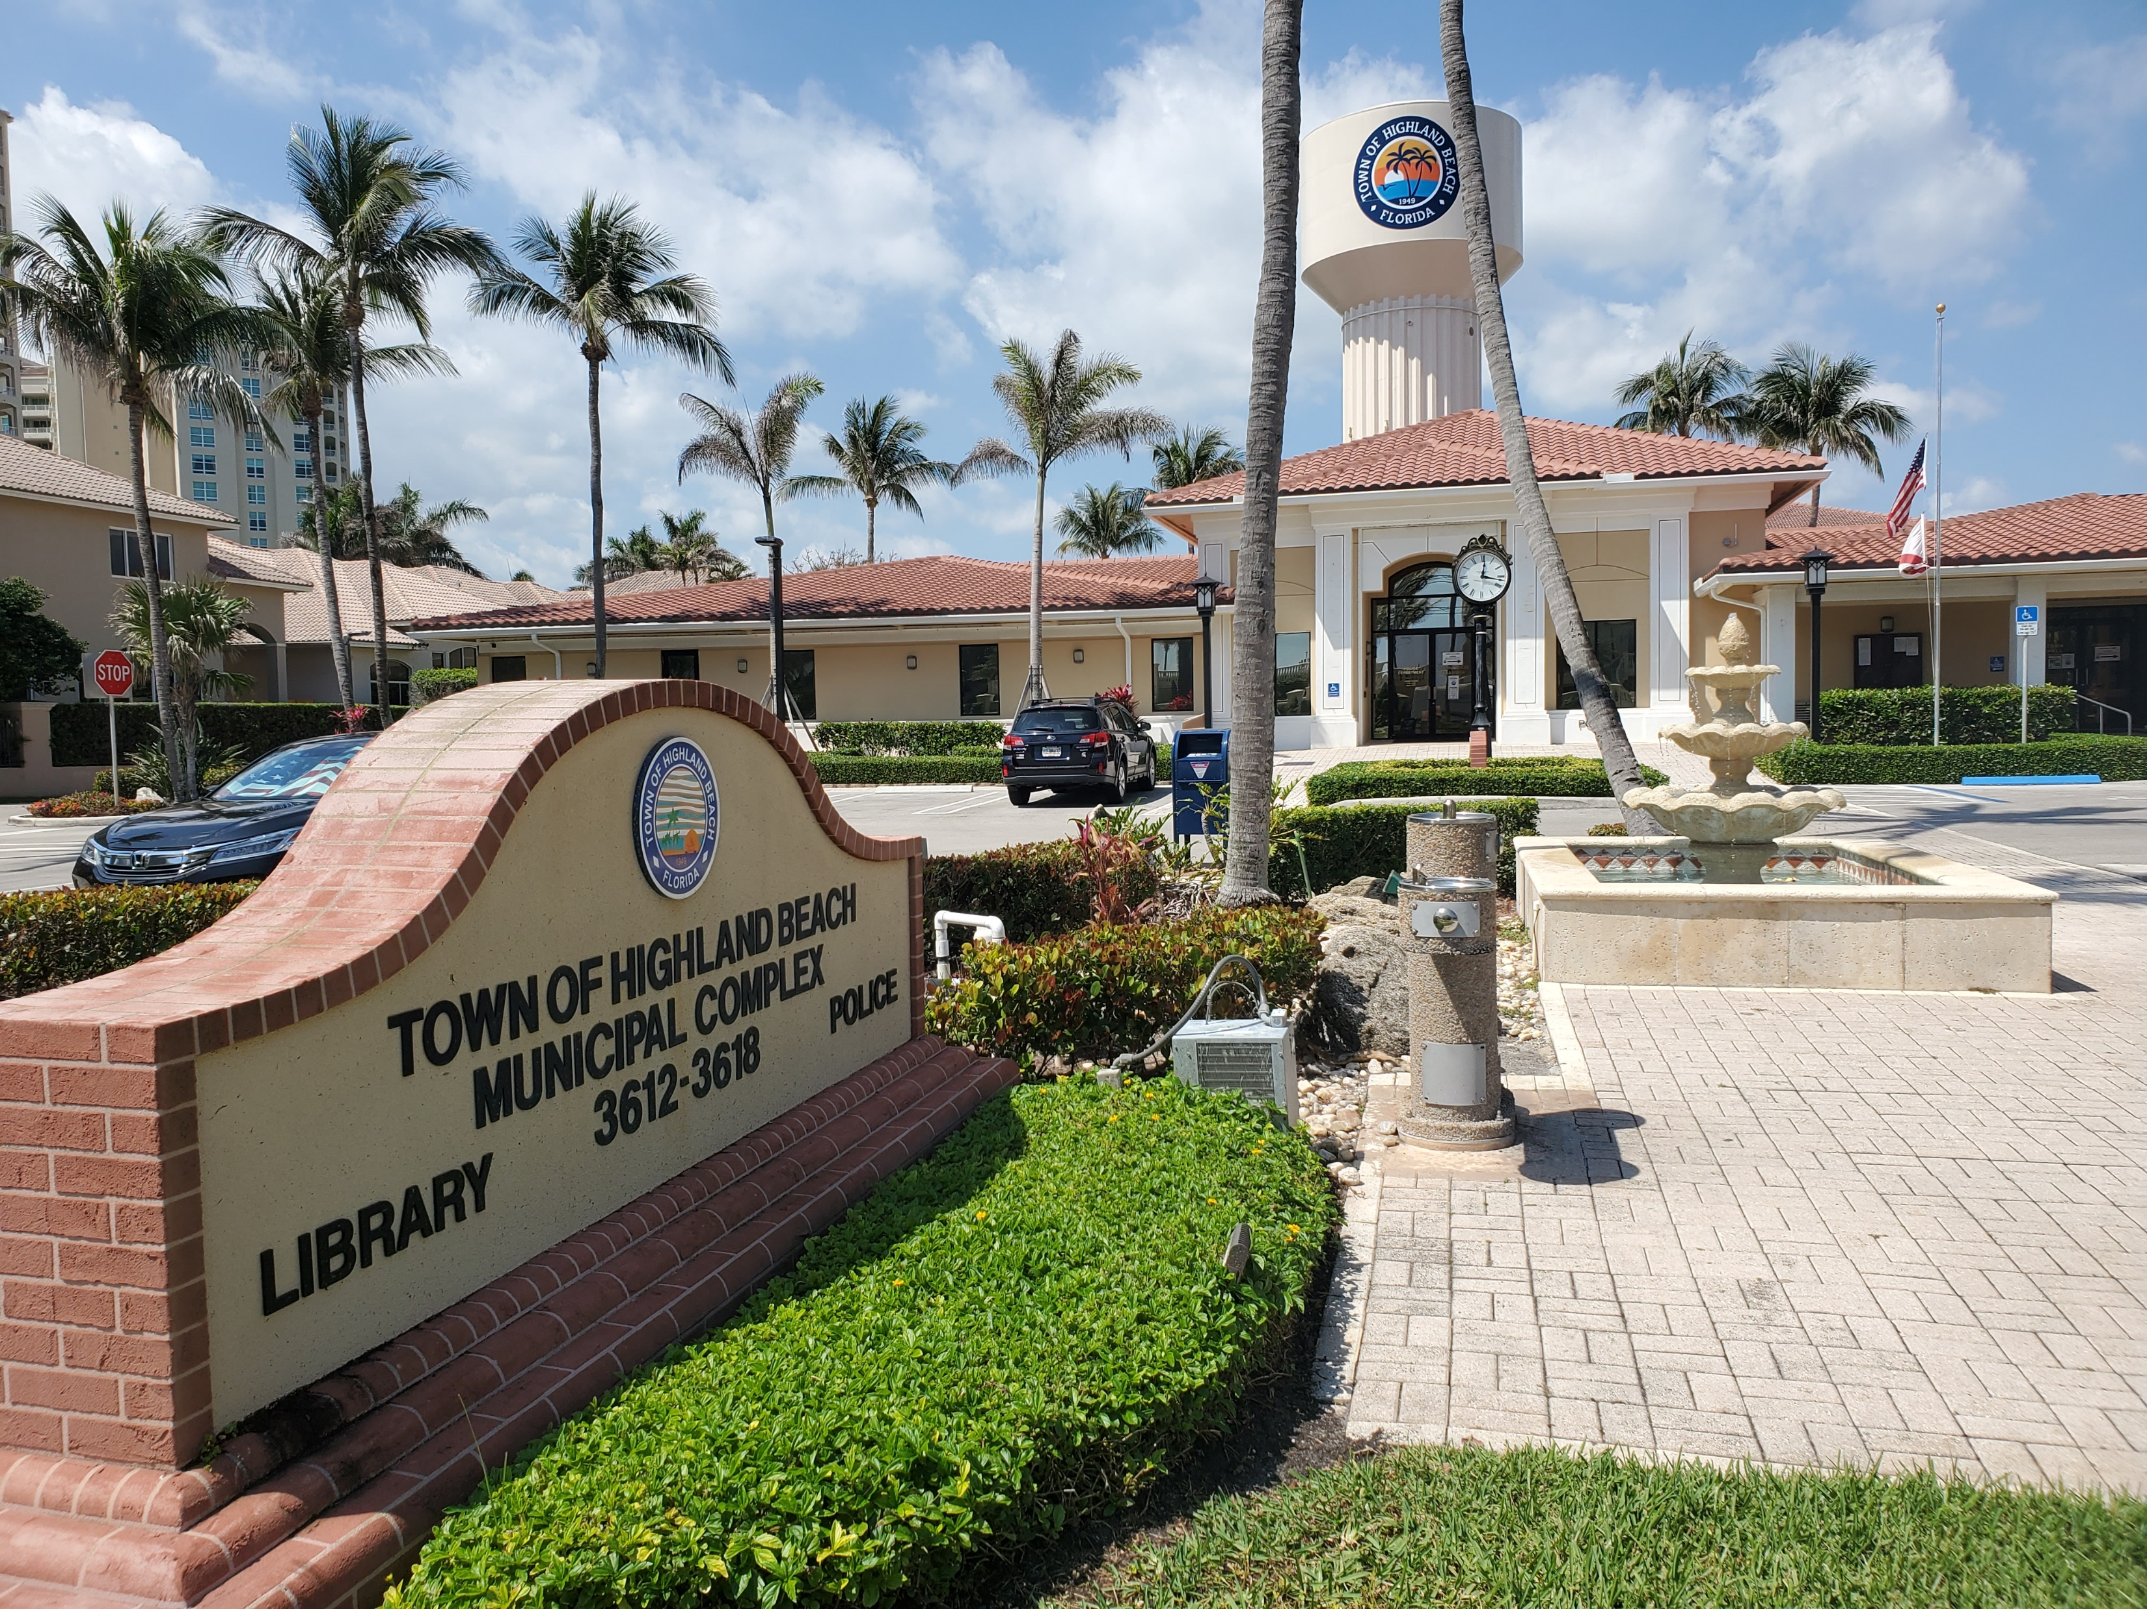
Overview of Proposed FY 2023 Operating Budget
September 6, 2022

Slide 2
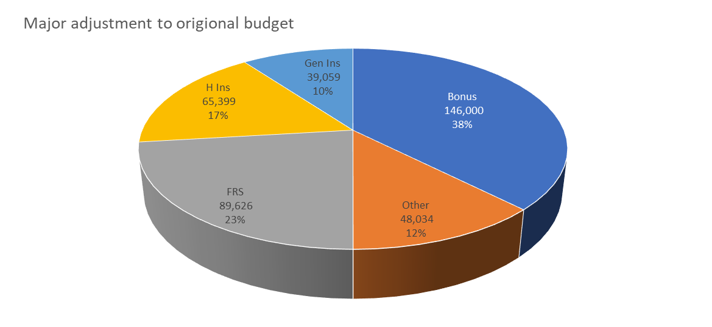

FY 2023 Updated Preliminary Budget Overview
Slight (1%) Decrease in Millage Rate proposed
  Recognized a 13.75% increase in Taxable Value
  Reduction in Debt Service Millage (0.0350 mills) as part of Water Rate Transition
NEED to balance with pledged reserve funds (Fund Balance)
  Reduced from $642,000 in the prior year
  Reduced from $642,000 in the prior year to $312,254

Slide 3
FY 2023 Updated Preliminary Budget Overview (Cont.)
Increase in Fire-Rescue budget of $712,832 (13% increase) $738,045 (14% increase)
  4% increase from City of Delray Beach Interlocal Agreement
  1 Fire Chief Position (Change due to Bonus, Insurance, FRS & other)
  Design/Consulting Fees – (Does not include Fire Station construction activity)
  1 EMS Vehicle
Funding of Capital Projects
  North & South Entry Signs - $150,000
  Road/Bridge Repairs - $100,000
  Rehab Lift Station #2 - 150,000
  Replace VFDs for Wells, Feed and Transfer Pumps - $300,000
Florida Retirement System (FRS)
Adjusted for FY2023 change in rate plus the potential change in the following year.

Slide 4
FY 2023 Updated Preliminary Budget Overview (Cont.)
Funding of salaries and benefits under Collective Bargaining Agreements
  FOP Union fixed increase of 3.5% (Last year of current agreement)
  PBA Union step plan to increase range from 2% to 8.1% [depending on rank and step position](Last year of current agreement)
  Non-Union employees 5% plus Cost Adjustment to Salary Table
  Evaluation of one-time employee payment to address unsettled economic conditions at 3%
Effects each fund differently

Slide 5
FY 2023 Updated Preliminary Budget Overview (Cont.)
Funding of Employee benefits
  Assumed healthcare and related insurance increase of 7% (Preliminary) 14%

Slide 6
FY 2023 Updated Preliminary Budget Overview (Cont.)
Funding of Employee benefits
  Assumed healthcare and related insurance increase of 7% (Preliminary) 14%
NO price change in:
Short/Long Term Disability
Group/Voluntary Life Insurance
Vision

Slide 7
Updated Preliminary FY2023 Budget Summary

Slide 8
FY 2023 Strategic Projects/Initiatives
Fire-Rescue Department
Commence Construction of Fire Station
Procure Station Apparatus and Equipment
Recruit Fire Personnel
Formalize Operational Protocols
Marine Accessory Structures Ordinance
Town Entry Signs
PBA Collective Bargaining Agreement FY 2023-2026
FOP Collective Bargaining Agreement FY 2023-2026
Bel Lido Bridge Repairs
Rehabilitate Well No. 8
Replace VFDs for Water Plant
Improve Finance/Accounting Department Accuracy, Speed & Reporting
Human Resource/Personnel Policy and Procedures

Slide 9
FY 2023 Preliminary Millage Rate
Proposed Total Millage Rate
  Operating Millage Unchanged – 3.2294 Last 4 years
Reduction in Debt Service Millage
  From 0.3931 to 0.3581 – Reduction of 0.0350
  -8.9% due to transition in Water Rates
Combined Proposed Millage
3.2294 Mills
0.3581 Mills
3.5875 Mills

Slide 10
Total Millage Rate: Highland Beach
Proposed FY 2023
Taxing Authority | Millage Rate
Highland Beach Operating | 3.2294
Highland Beach Debt | 0.3581
Palm Beach County Operating | 4.7815
Palm Beach County Debt | 0.0334
School Board - Local | 3.248
School Board - State | 3.627
SFWMD | 0.1061
SFWMD - Okeechobee Basin | 0.1146
SFWMD - Everglades Const. | 0.0365
Children Services | 0.6233
Health Care District | 0.7261
Florida Inland Navigation District | 0.032
Total | 16.916

Slide 11
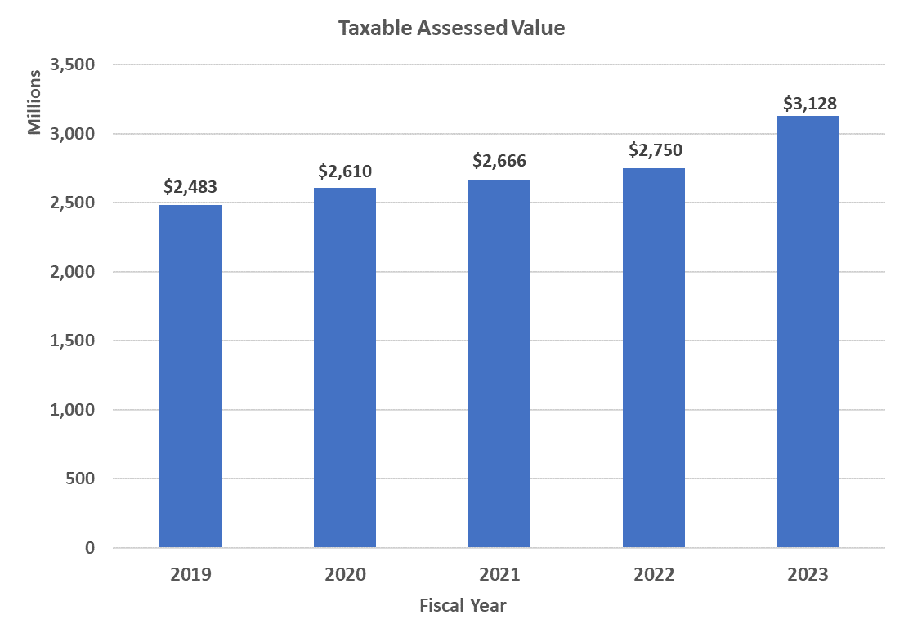
Town’s Taxable Assessed Value
13.75 % Change in Taxable Value (1 Year)
5.52% Average Annual Change in Taxable Value (5 Years)
6.01% Average Annual Change in Taxable Value (10 Years)
Increase in assessed value by 2.7% from June to July

Slide 12
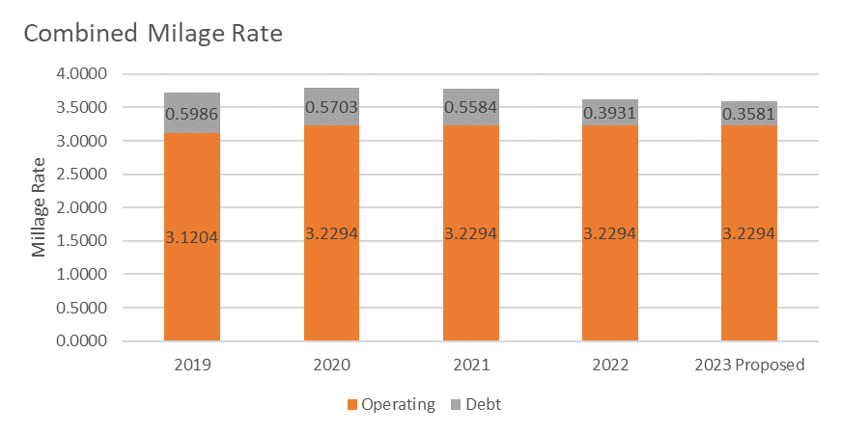
Town’s Proposed Tax Rate
Maximum Millage adjusted Debt to 0.3706 mills
Maximum not to exceed millage set at 3.6000 on July 19th meeting
Proposed millage remains at 3.5875 mills
Total Millage Rate Change of -1.0% as compared to prior year

Slide 13
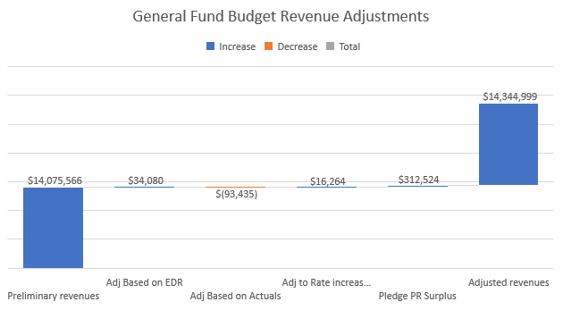
Updated Preliminary FY2023 General Fund Revenues
Slight increase in preliminary revenues (Local Option Gas Tax, Revenue Sharing, etc.) based upon latest estimates
Reduced preliminary revenues for certification, copies & Lien Search, and other miscellaneous revenues
Slight increase in preliminary revenues for 3% increase in Garbage
Pledge $313K from the FY2022 surplus
Net Change: $269,433

Slide 14
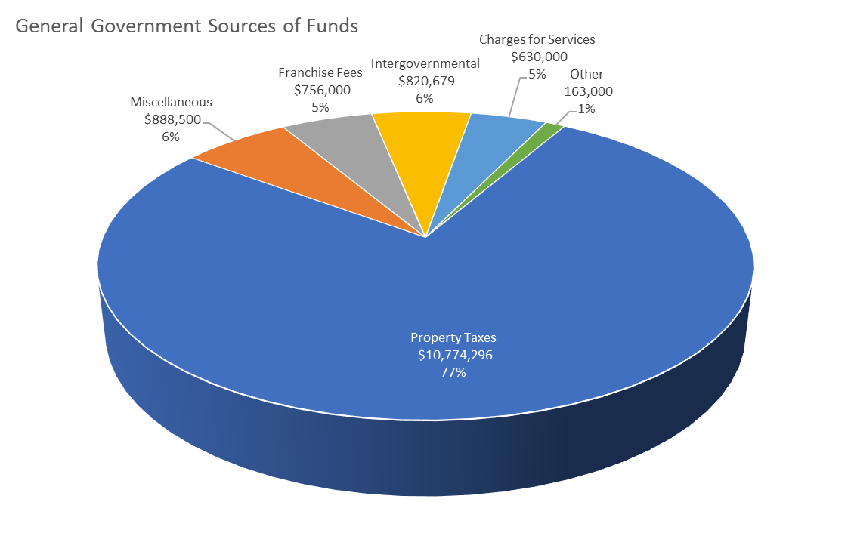
Preliminary Updated FY2023 General Fund Revenues
Ad Valorem (Property Tax) continues to represent over 77% of General Revenues.
Miscellaneous revenues are administrative reimbursements from other funds (Water, Sewer, Building) to cover shared expenditures.
Intergovernmental revenues are shared revenues from the State (Gas Tax, Sales Tax, etc.).
General Fund Change of $269,433 or 1.9% compared to original preliminary budget

Slide 15
Preliminary FY2023 General Fund Revenues (Cont.)
No Change in Property Taxes (Ad Valorem) assumption
Minor adjustments to other sources of revenue based on the most recent EDR (Economic & Demographic Research)
Pledge from anticipated FY2022 Surplus

Slide 16
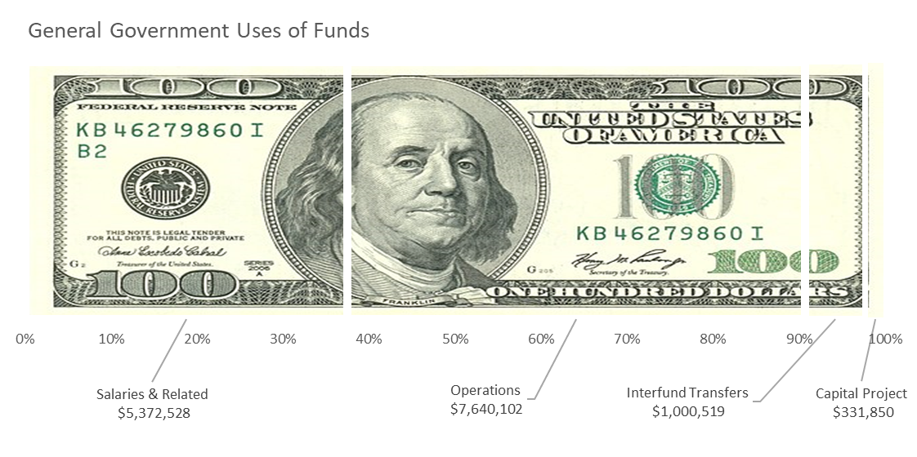
Preliminary Updated FY2023 General Fund Expenditures
Salaries & Related 37% of the total budget. The estimated increase in budget is based on full staffing levels (4 additional FTEs) plus an anticipated merit increase and increase in healthcare costs.
  Adjusted for Economic Relief Bonus, Health Insurance & FRS
Operating expenditures represent approximately 53% of the total budget.
  Adjusted for Change in General Insurance increase
Capital Projects include the anticipated purchase of a Fire Rescue vehicle at $275K
Decrease in Interfund Transfers (from Water Fund) due to reduction in DS Millage.
Overall increase in General Fund Expenditures of 5.6%.
  Additional Adjustment of 1.9%

Slide 17
Preliminary Updated FY2023 General Fund Expenditures (Cont.)
Created a new Shared Support Services Department to track general governmental shared services between departments and funds. Shifted staff from Town Manager and added 1 new position. Shifted communication, network, and other IT-related costs from other departments into Shared Support Services Department.
Fire Rescue fund increase includes new Fire Chief position and related benefits and increases in Fire Rescue contract with the City of Delray Beach.
Increase 1 new staff position within the Public Works Department.
Updated for increases in:
  Economic Relief Bonus
  Health Insurance Cost
  FRS Pension Cost
  General Insurance Cost

Slide 18
Preliminary Updated FY2023 General Fund Expenditures Summary
3% of Current Salary
Budget for Required Payroll Taxes (Towns Portion)
Required FRS Contribution

Slide 19
Preliminary Updated FY2023 General Fund Expenditures Summary

Slide 20
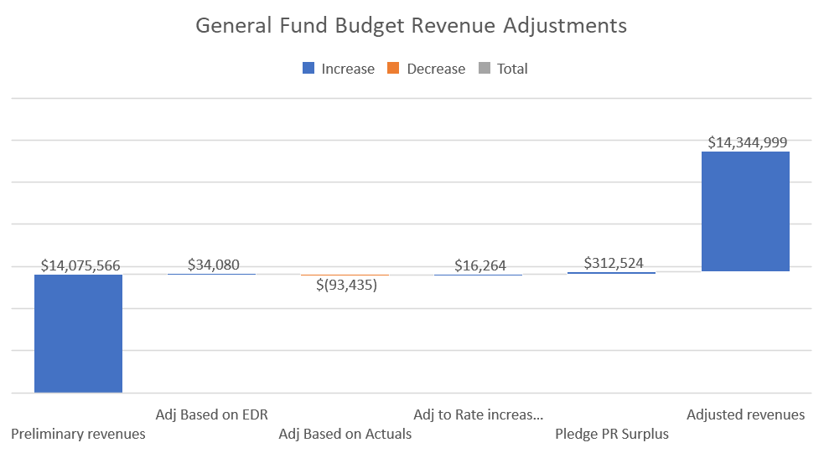
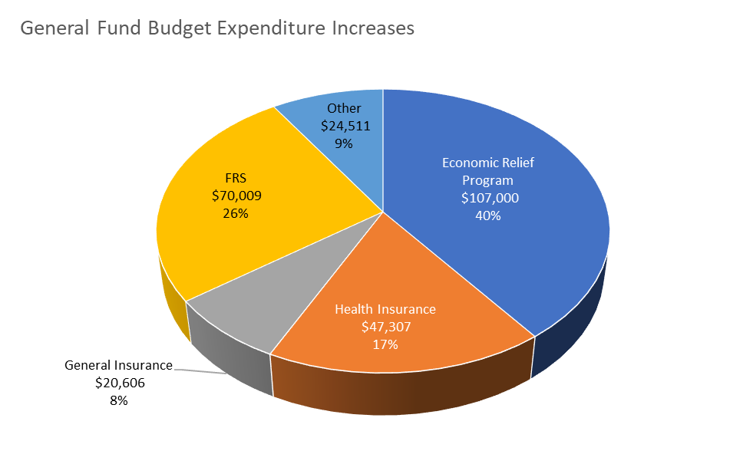
Preliminary Updated FY2023 General Fund Summary
Total Change: $269,433

Slide 21
Preliminary FY2023 Discretionary Sales Surtax Fund
Preliminary projections indicate an increase in Discretionary Sales Tax revenue from the State of Florida.
Shifting Discretionary Sales Tax capital projects from FY2022 into FY2023 (Town Entry Signs) $150K.
Road/Bridge Repairs $100K.

Slide 22
Preliminary FY 2023 Capital Projects

Slide 23
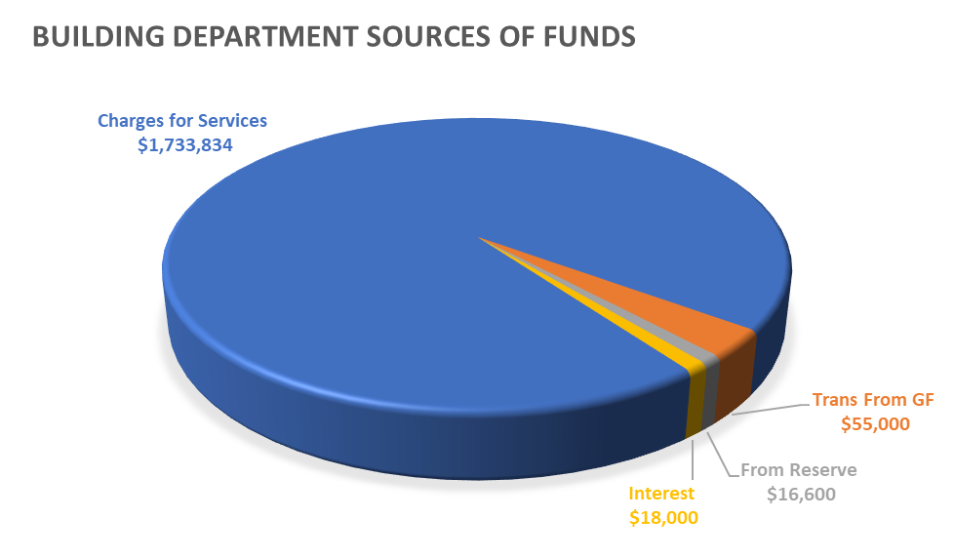
Preliminary Updated FY2023 Building Department (Revenues)
Charges for Services represent over 95% of the total revenue associated with this fund. FY2023 Preliminary Budget is based on a conservative projection of FY2022 actuals plus potential ILA revenue of $447K
Transfer from General Fund represents a fixed amount of allocated labor for planning and zoning activity
Discount of 10% to Highland Beach Residents only has been budgeted
Pledge from FY2022 anticipated surplus to cover Economic Relief Bonus

Slide 24
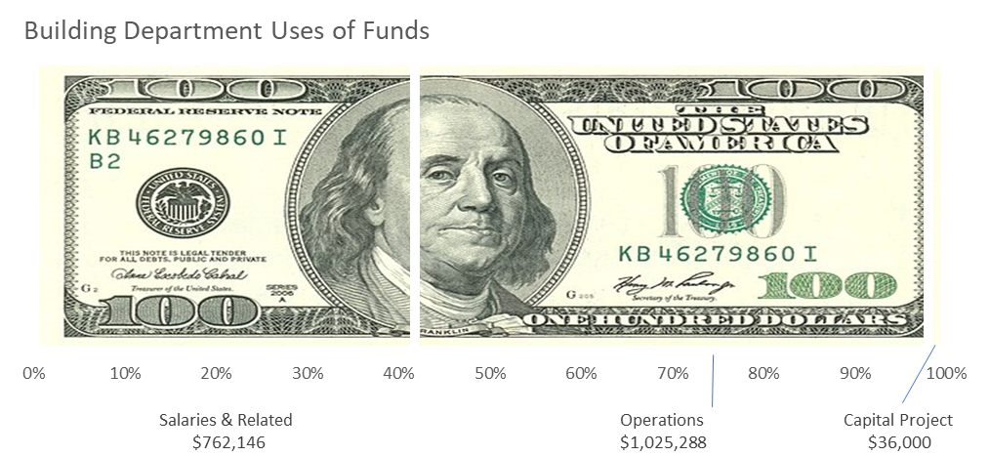
Preliminary Updated FY2023 Building Department (Expenditures)
Increase in Salaries & Related predominately driven by an increase in anticipated cost of living and related increase in benefits. Including Economic Relief Bonus, FRS, and Increases in Health and related insurance.
Increase in operational cost associated with an anticipated increase in sub-contracted inspection services associated with potential ILA activity. Including small adjustment for General Insurance Increase
Minimal Capital Projects are anticipated in FY2023 primarily due to the completion of FY2021 and FY2022 Capital Projects.

Slide 25
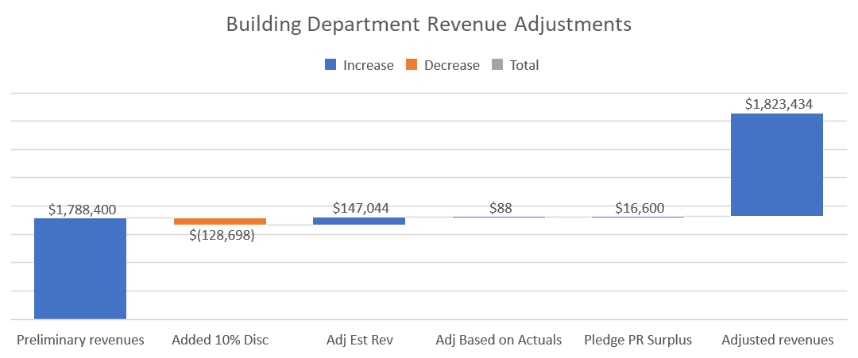
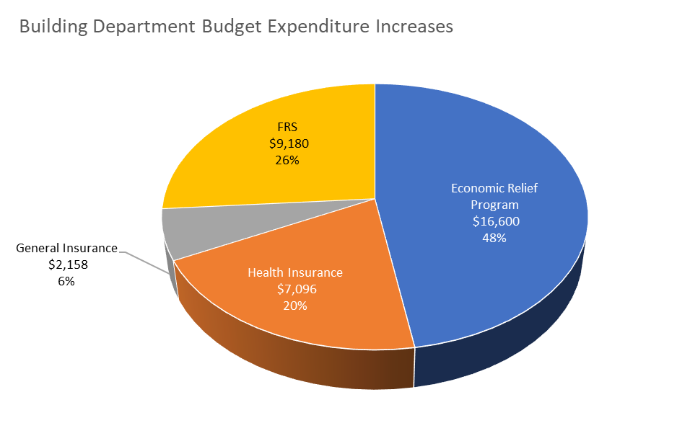
Preliminary Updated FY2023 Building Department Summary
Total Change: $35,034

Slide 26
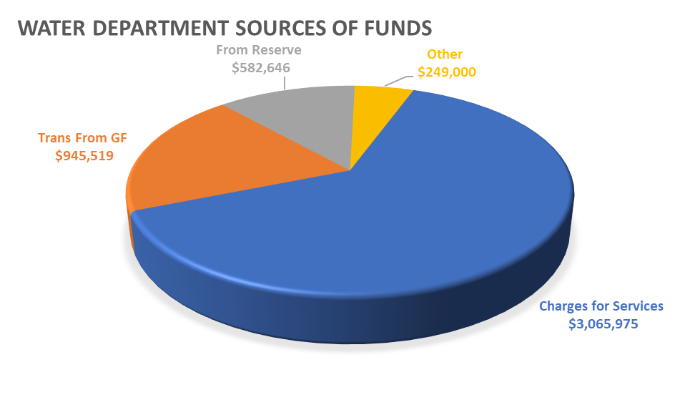
Preliminary Updated FY2023 Water Fund (Revenues)
The preliminary Budget assumed a 10% rate increase as forecasted by the consultant.
Assumed no additional ARPA funds during FY2023.
FY2023 Preliminary Updated Revenue is increased based on forecasted actuals through the 5th billing cycle
Transfer from GF is reduced which coincides with consultants’ forecast.
Pledge from reserves is reduced due to the overall increase in water sales through the 5th billing cycle

Slide 27
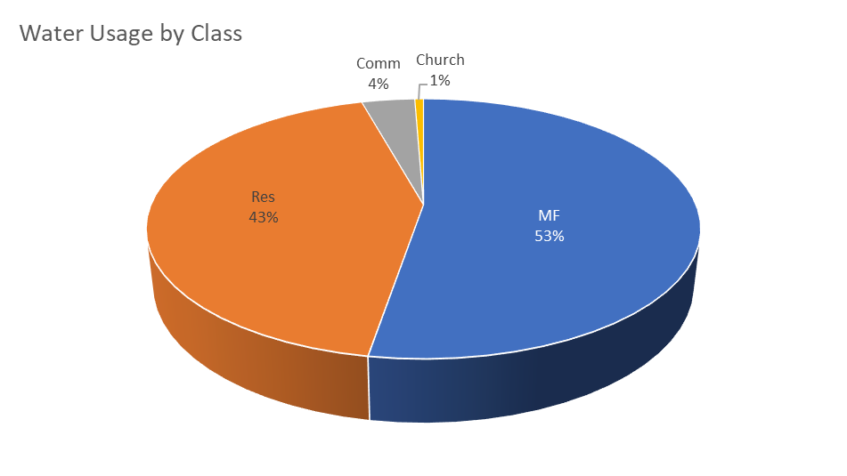
Preliminary Updated FY2023 Water Fund (Revenue Data)
The Multi-Family Service Class (includes Condos) Represents 53% of the water usage
Comparing the first 5 billing cycles of the Prior Year (FY2021) to the 5 billing cycles of the current year (FY2022), we are up over 2%... But our largest water users are down by 17%

Slide 28
Preliminary FY2023 Water Fund (Revenue Data)
Water rates were adjusted and reconfigured effective April 1, 2021, to add additional tiers and an irrigation customer class. Usage rates were adjusted by 11% while base fees remained constant.
10% rate increase is projected for both base and usage fees.

Slide 29
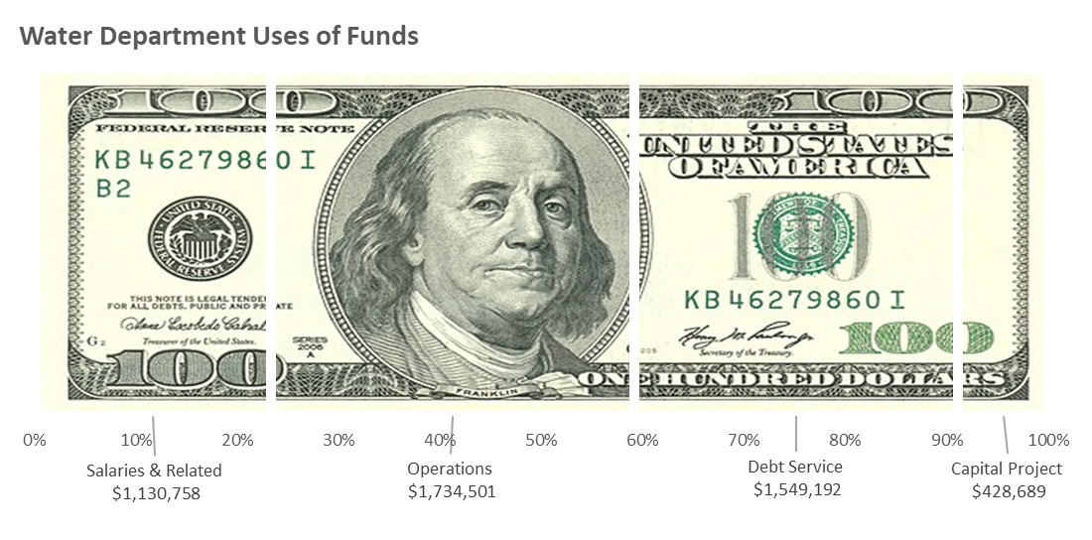
Preliminary FY2023 Water Fund (Expenditures)
Moderate increase in Salaries & Related (Department is fully staffed). Including Economic Relief Bonus, FRS, and Increases in Health and related insurance.
Preliminary Operations budget based on FY2022 projected expenditures. Including small adjustment for General Insurance Increase
No change in Capital Project Expenditures.
Level Debt Service.
Overall decrease in expenditures of 2.9% primarily due to lower operations costs and slightly reduced Capital Projects.
  Additional Increased Adjustment of 1.2%

Slide 30
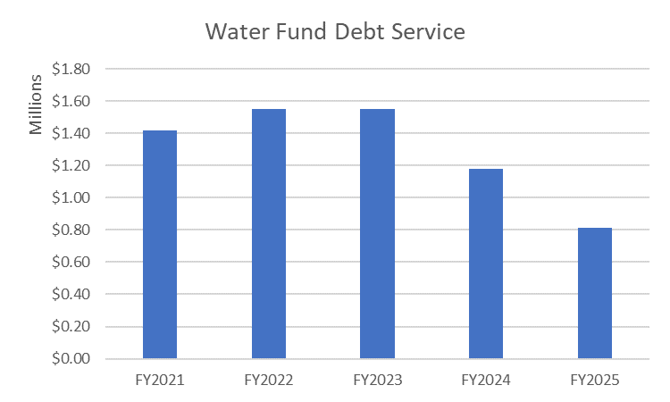
Preliminary FY2023 Water Fund (Expenditure Data)
Debt Service remains constant through FY2023 and reduces in FY2024 by $369K and FY2025 by another $369K.

Slide 31
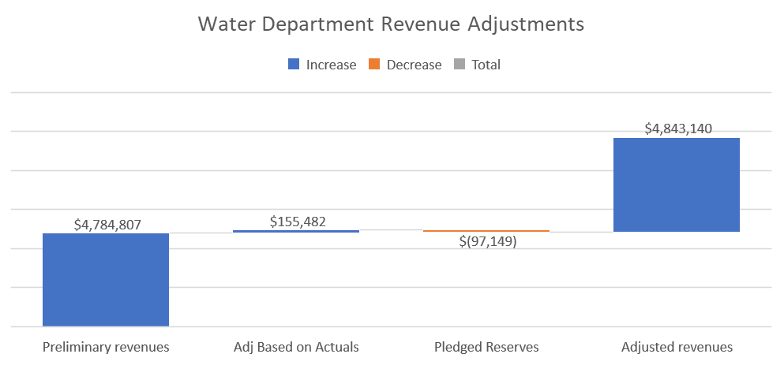
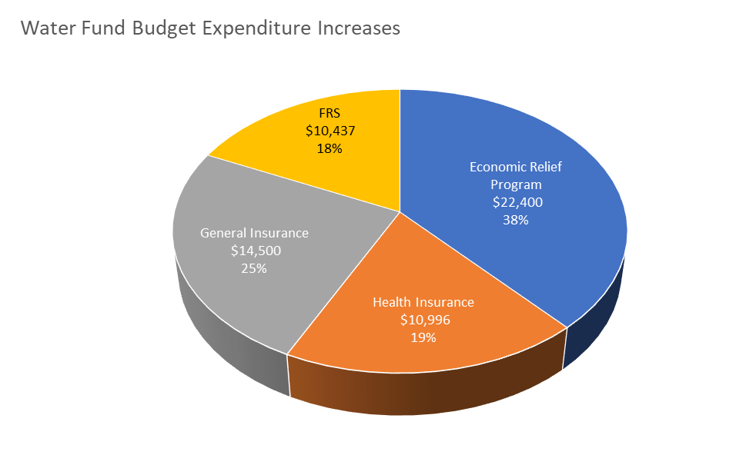
Preliminary Updated FY2023 Water Fund Summary
Total Change: $58,333

Slide 32
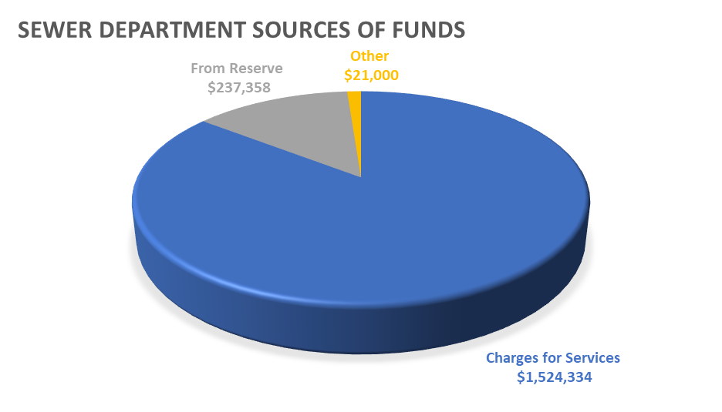
Preliminary FY2023 Sewer Fund (Revenues)
The preliminary Budget assumed a 12% rate increase as forecasted by the consultant.
Sewer revenue is projected to be less than the FY2022 budget by ($207K). Sewer cap set at 20Kgal Bi-monthly and reduced water usage.
Assumed no additional ARPA funds during FY2023.
Budgeting a $237K pledge from reserve to bridge the budget gap.

Slide 33
Preliminary FY2023 Sewer Fund (Revenue Data)
Sewer rates were adjusted and reconfigured effective April 1, 2021, to add a usage rate and tier. Rates were adjusted by 13% while base fees remained constant.
12% rate increase is projected for both base and usage fees.

Slide 34
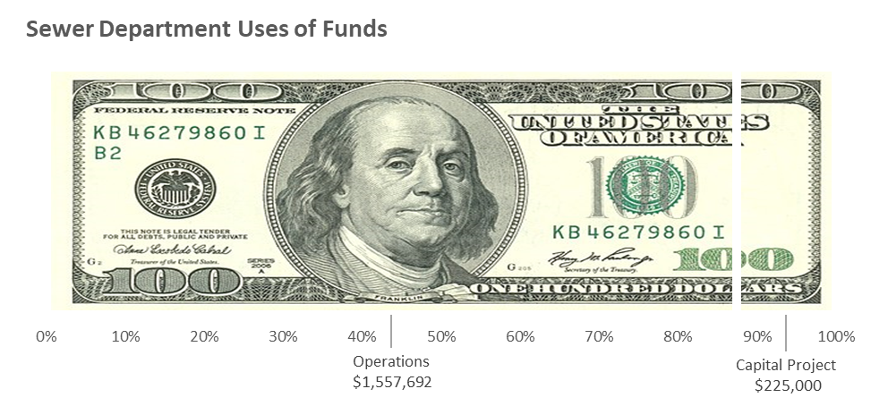
Preliminary FY2023 Sewer Fund (Expenditures)
Preliminary Operations budget based on FY2022 projected expenditures and increase from the City of Delray Beach for Treatment costs.
Reduction in Capital Project Expenditures.
Added Reserve for Contingency $25K

Slide 35
FY 2023 Updated Budget Summary
Proposed Millage set at 3.5875 mills (1% reduction from the prior year) Maximum Millage at 3.6000
Pledge from FY2022 anticipated surplus of $313K General Fund
  Economic Relief Bonus
  Health & General Insurance Increase
  FRS Retirement Increase
General Fund increase was driven mainly by an increase in the Fire Rescue budget
Discretionary Sales Tax decrease due to completion of prior year projects offset by an increase in anticipated revenues
Building Department increase was driven by the continued increase in building activity plus potential ILA with Gulfstream and
  Economic Relief Bonus
  Health & General Insurance Increase
  FRS Retirement Increase
Water Fund decrease is the result of a reduction in ARPA funds in FY2023, offset by a rate increase of 10% per plan and
  Economic Relief Bonus
  Health & General Insurance Increase
  FRS Retirement Increase
Sewer Fund decrease is the result of a reduction in ARPA funds in FY2023, offset by a rate increase of 12% per plan - $25K Contingency
$270K Increase
$35K Increase
$58K Increase

Slide 36

FY 2023 Budget Calendar Events
August 4, 18, 25
Special Budget Meetings
September 16th
September 6th
Public Hearing to tentatively adopt proposed millage and proposed budget
Budget Ad to newspaper
September 21st
Town Commission adopts final budget, final millage
Setting tentative maximum millage rate
July 7th FAB Meeting
Continued budget discussions
July 19th
1st reading of levy
FAB concurrence
Maximum Millage Rate
Water rate increase as planned
Sewer Rate increase as planned
Maximum Millage Rate set at 3.6000
Water rate increase as planned
Sewer Rate increase as planned
Update Budget for:
  Economic Relief Bonus
  Health & General Insurance Increases
  FRS Increases
Sent Budget Ad to Florida Department of Revenue for Review. We are good to go ready to launch.

Slide 37
FY 2023 Budget
Questions

